Slide 1

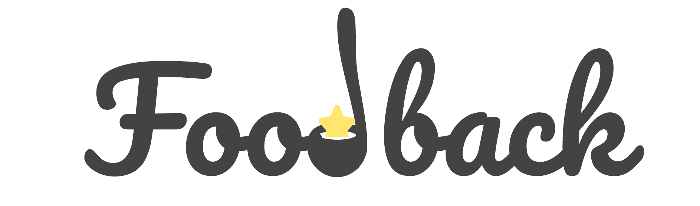


UNIVERSITÀ DI PISA
Sensing how consumers experience Food
Tommaso Califano · Giovanni Ligato · Nicola Ramacciotti · Gabriele Suma
Master’s degree in Computer Engineering
Mobile and Social Sensing Systems
Marco Avvenuti · Alessio Vecchio

Slide 2

Why Foodback?
Most dining experiences go unrecorded—people simply don’t have the time, interest, or motivation to write reviews.
Setting the Table

Slide 3
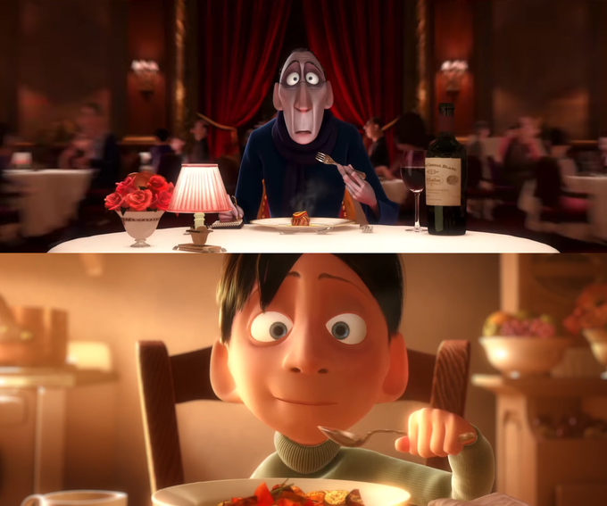
Yet every bite tells a story
Our goal is to capture that story—automatically.

Slide 4



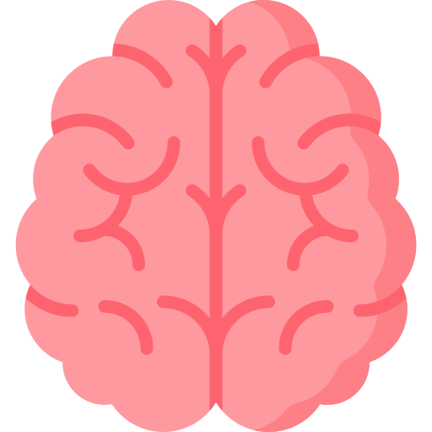
What we Propose
A mobile-based prototype that evaluates food experiences by analyzing brain and body signals. Bringing objectivity and automation to digital gastronomy.
+
No user input required

Slide 5






Inside the Foodback Experience
Inside the Foodback Experience
Foodback
Foodback

Slide 6


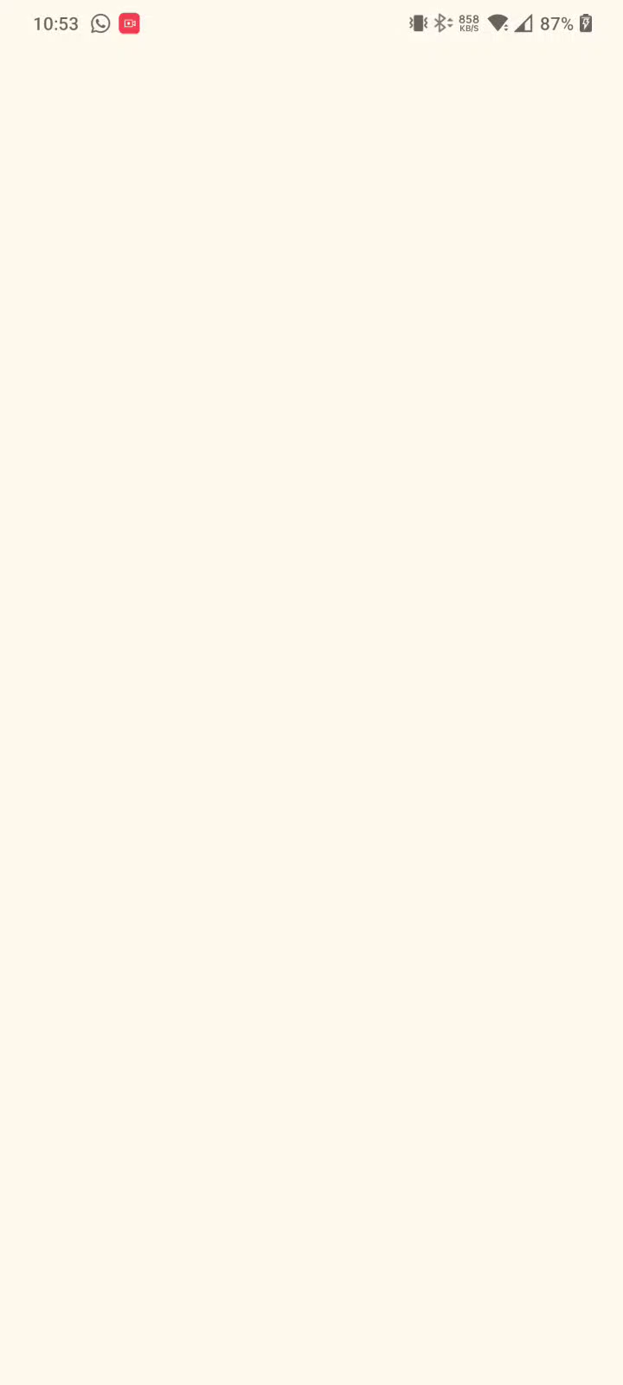


Splash Screen

Slide 7
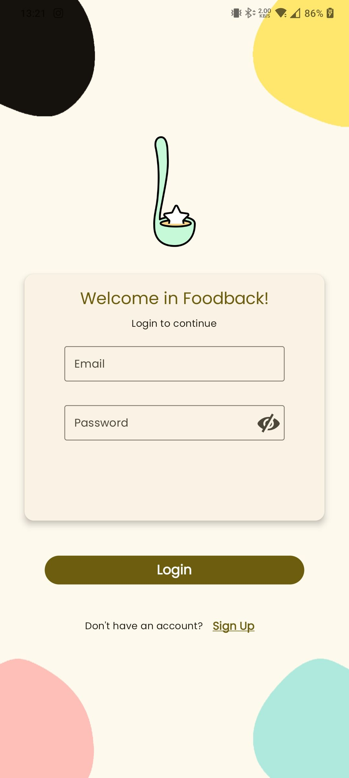
Login Made Simple
Users can access Foodback’s features quickly and securely using just their email and password—nothing more.
Login Screen

Slide 8
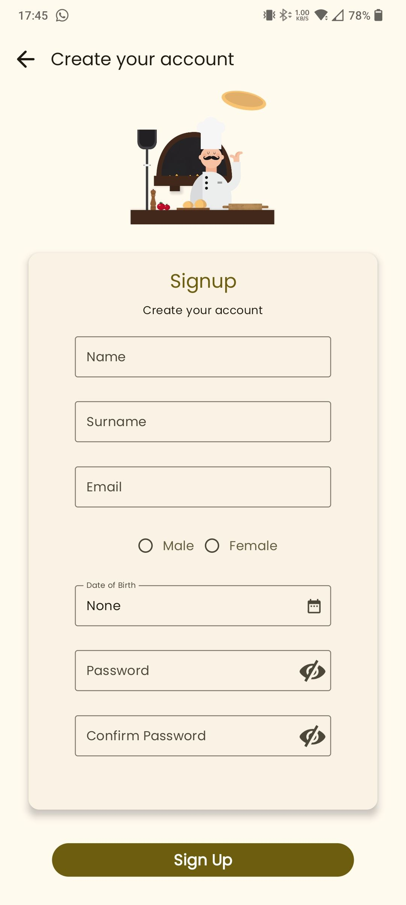

No account? No problem.
You can easily register for Foodback anytime through the sign-up page.
Sign-Up Screen

Slide 9
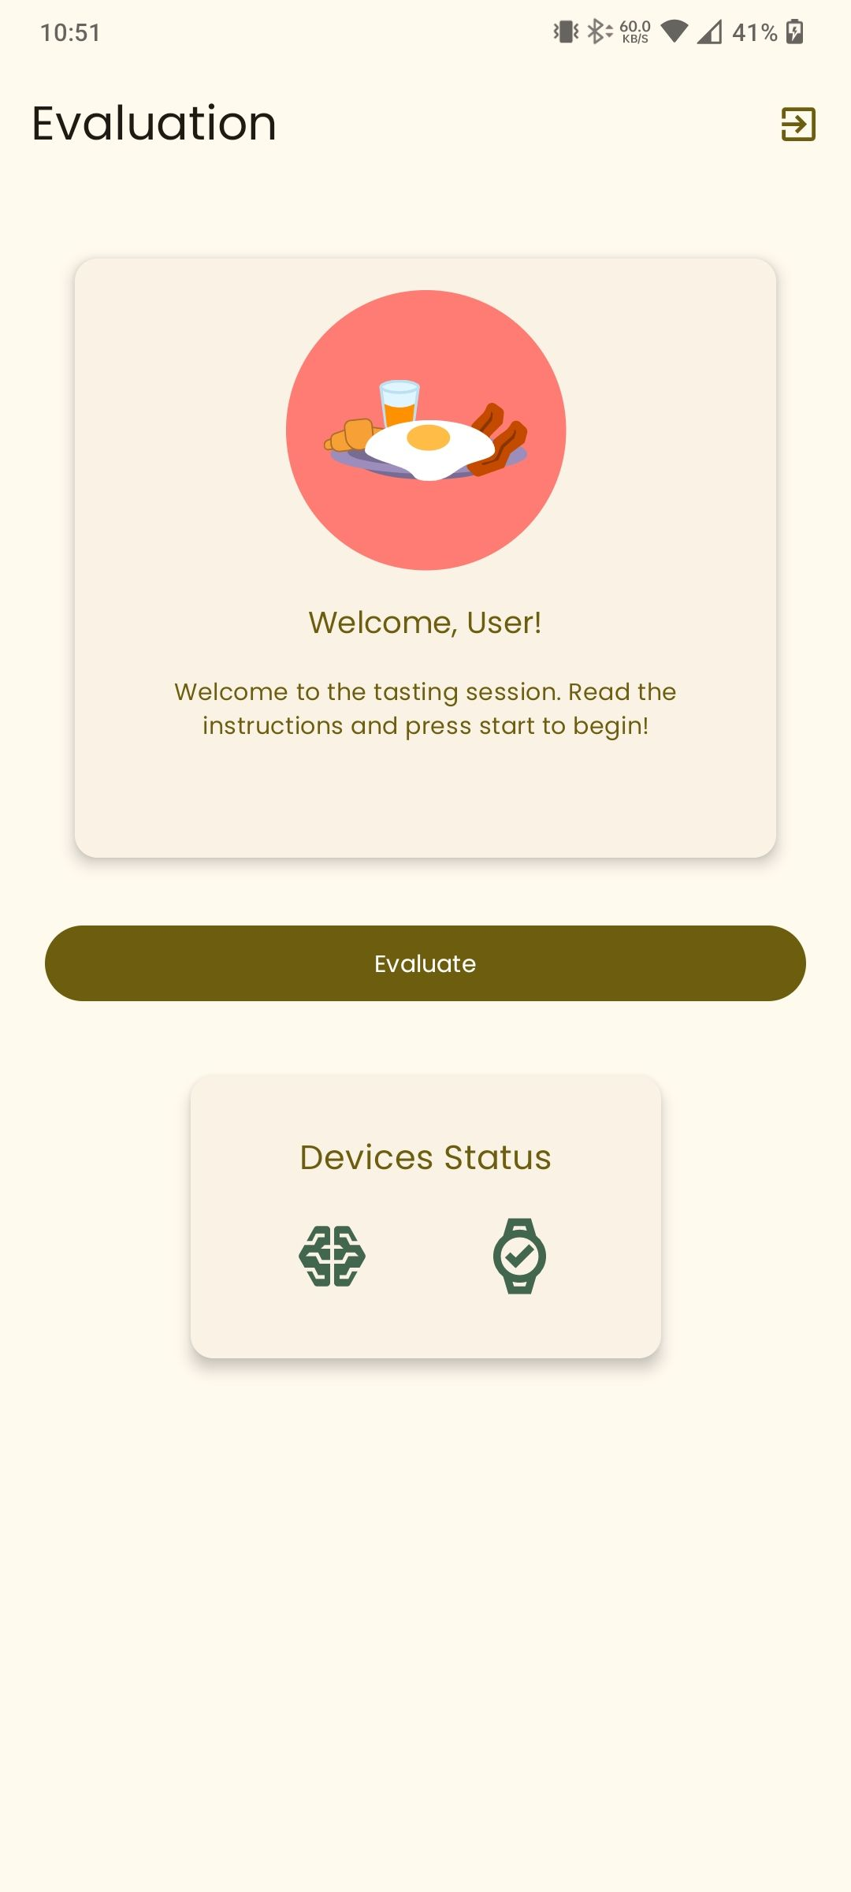

From Login to Evaluation
After logging in, users are directed to their main dashboard, where the pre-trained machine learning model is ready to evaluate tasting experiences automatically.
Both the EEG cap and the smartwatch must be connected—indicated by green icons—before the app allows inference to proceed.
Evaluation Screen

Slide 10

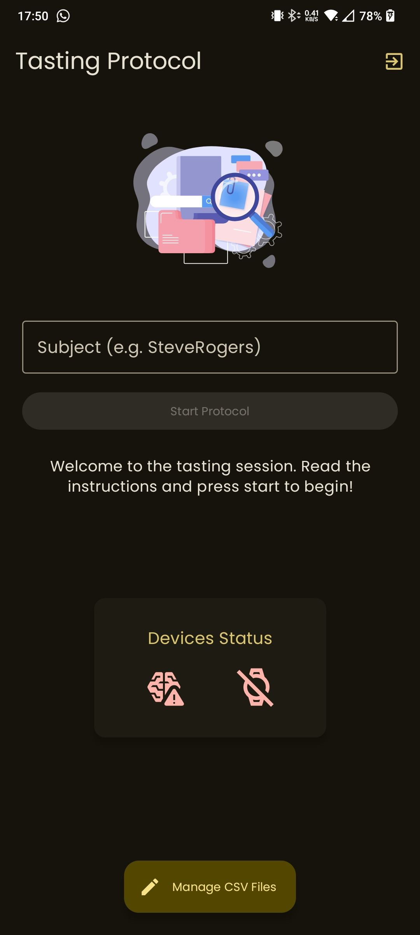
The Secret Ingredient
If the logged-in user is an Admin, an alternate route is revealed. Instead of the standard dashboard, the Admin accesses a dedicated data collection interface, used to gather EEG and smartwatch signals for training the machine learning model.
This experimental page enables controlled sessions across multiple participants and will be detailed further in the protocol discussion.
Data Collection Screen

Slide 11





SYSTEM ARCHITECTURE
EEG
MindRove ARC
Backend
Flask
Database
MySQL
Smartwatch
Google Pixel Watch 2
Mobile Phone
Heart Rate
Electrodermal Activity

Slide 12




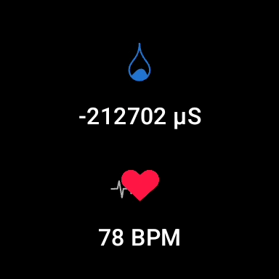

Companion Application
Powered by WearOS
Splash Screen
Main Screen

Slide 13




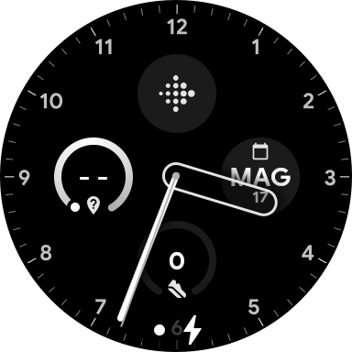


Android Wearable API
Part of Google Play Services
Provides a communication channel between wearable devices and connected handheld devices
WearOS
Android
Message Client API is a part of the Android Wearable API that enables sending short, one-way, real-time messages between connected devices

Slide 14

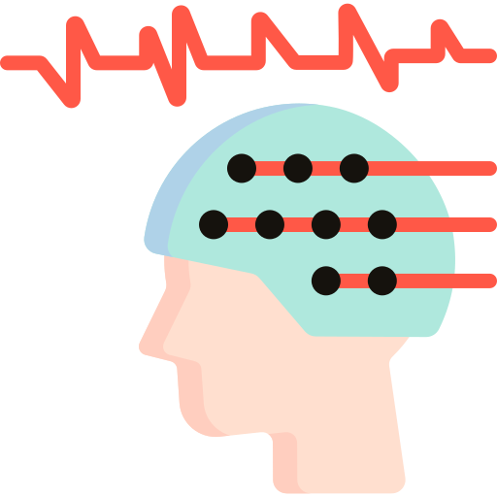


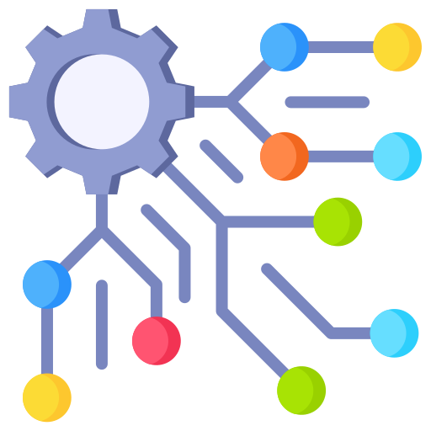

MINDROVE SDK
Mindrove SDK 2.0 for Android
The ServerManager class is responsible for managing a server thread and its interactions.
SensorData:
Channel[1-6]
NumberOfMeasurements
Voltage

Slide 15
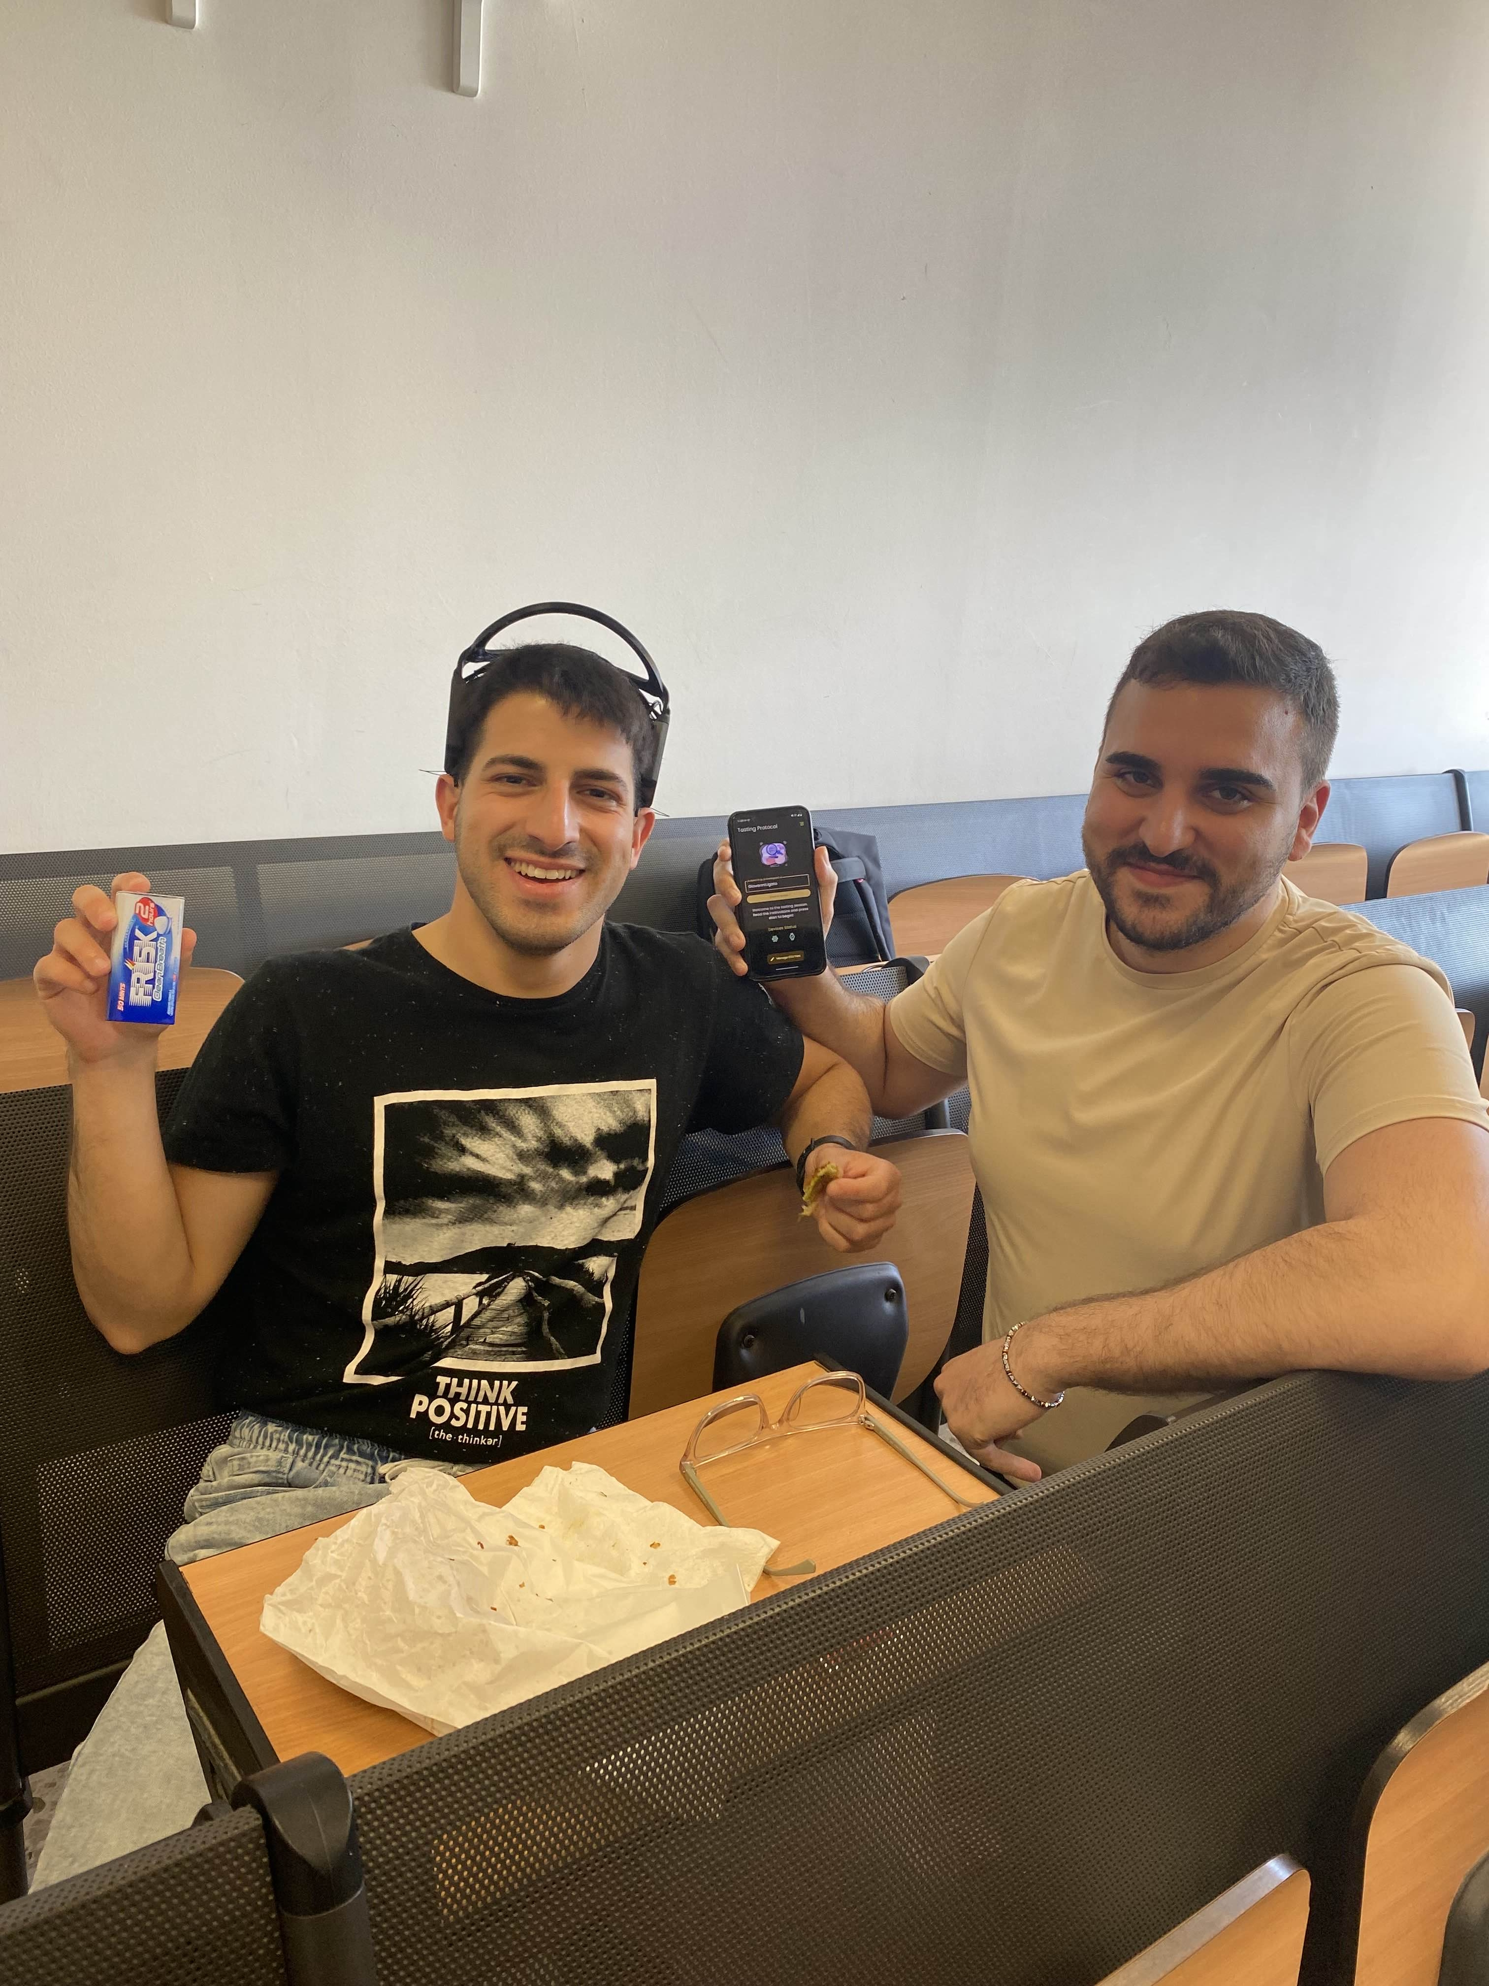
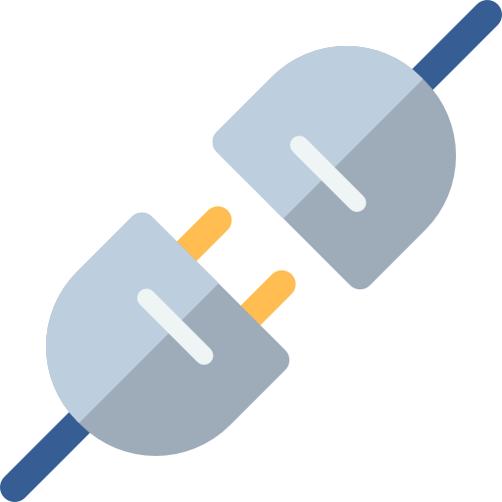

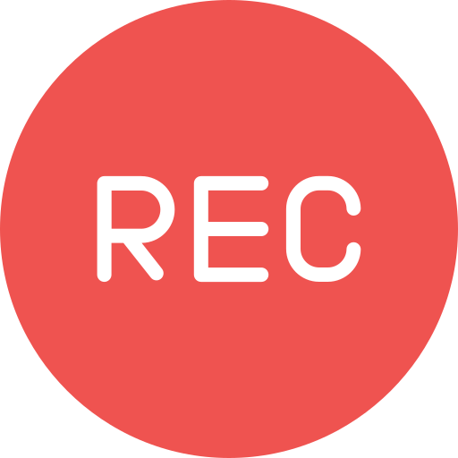
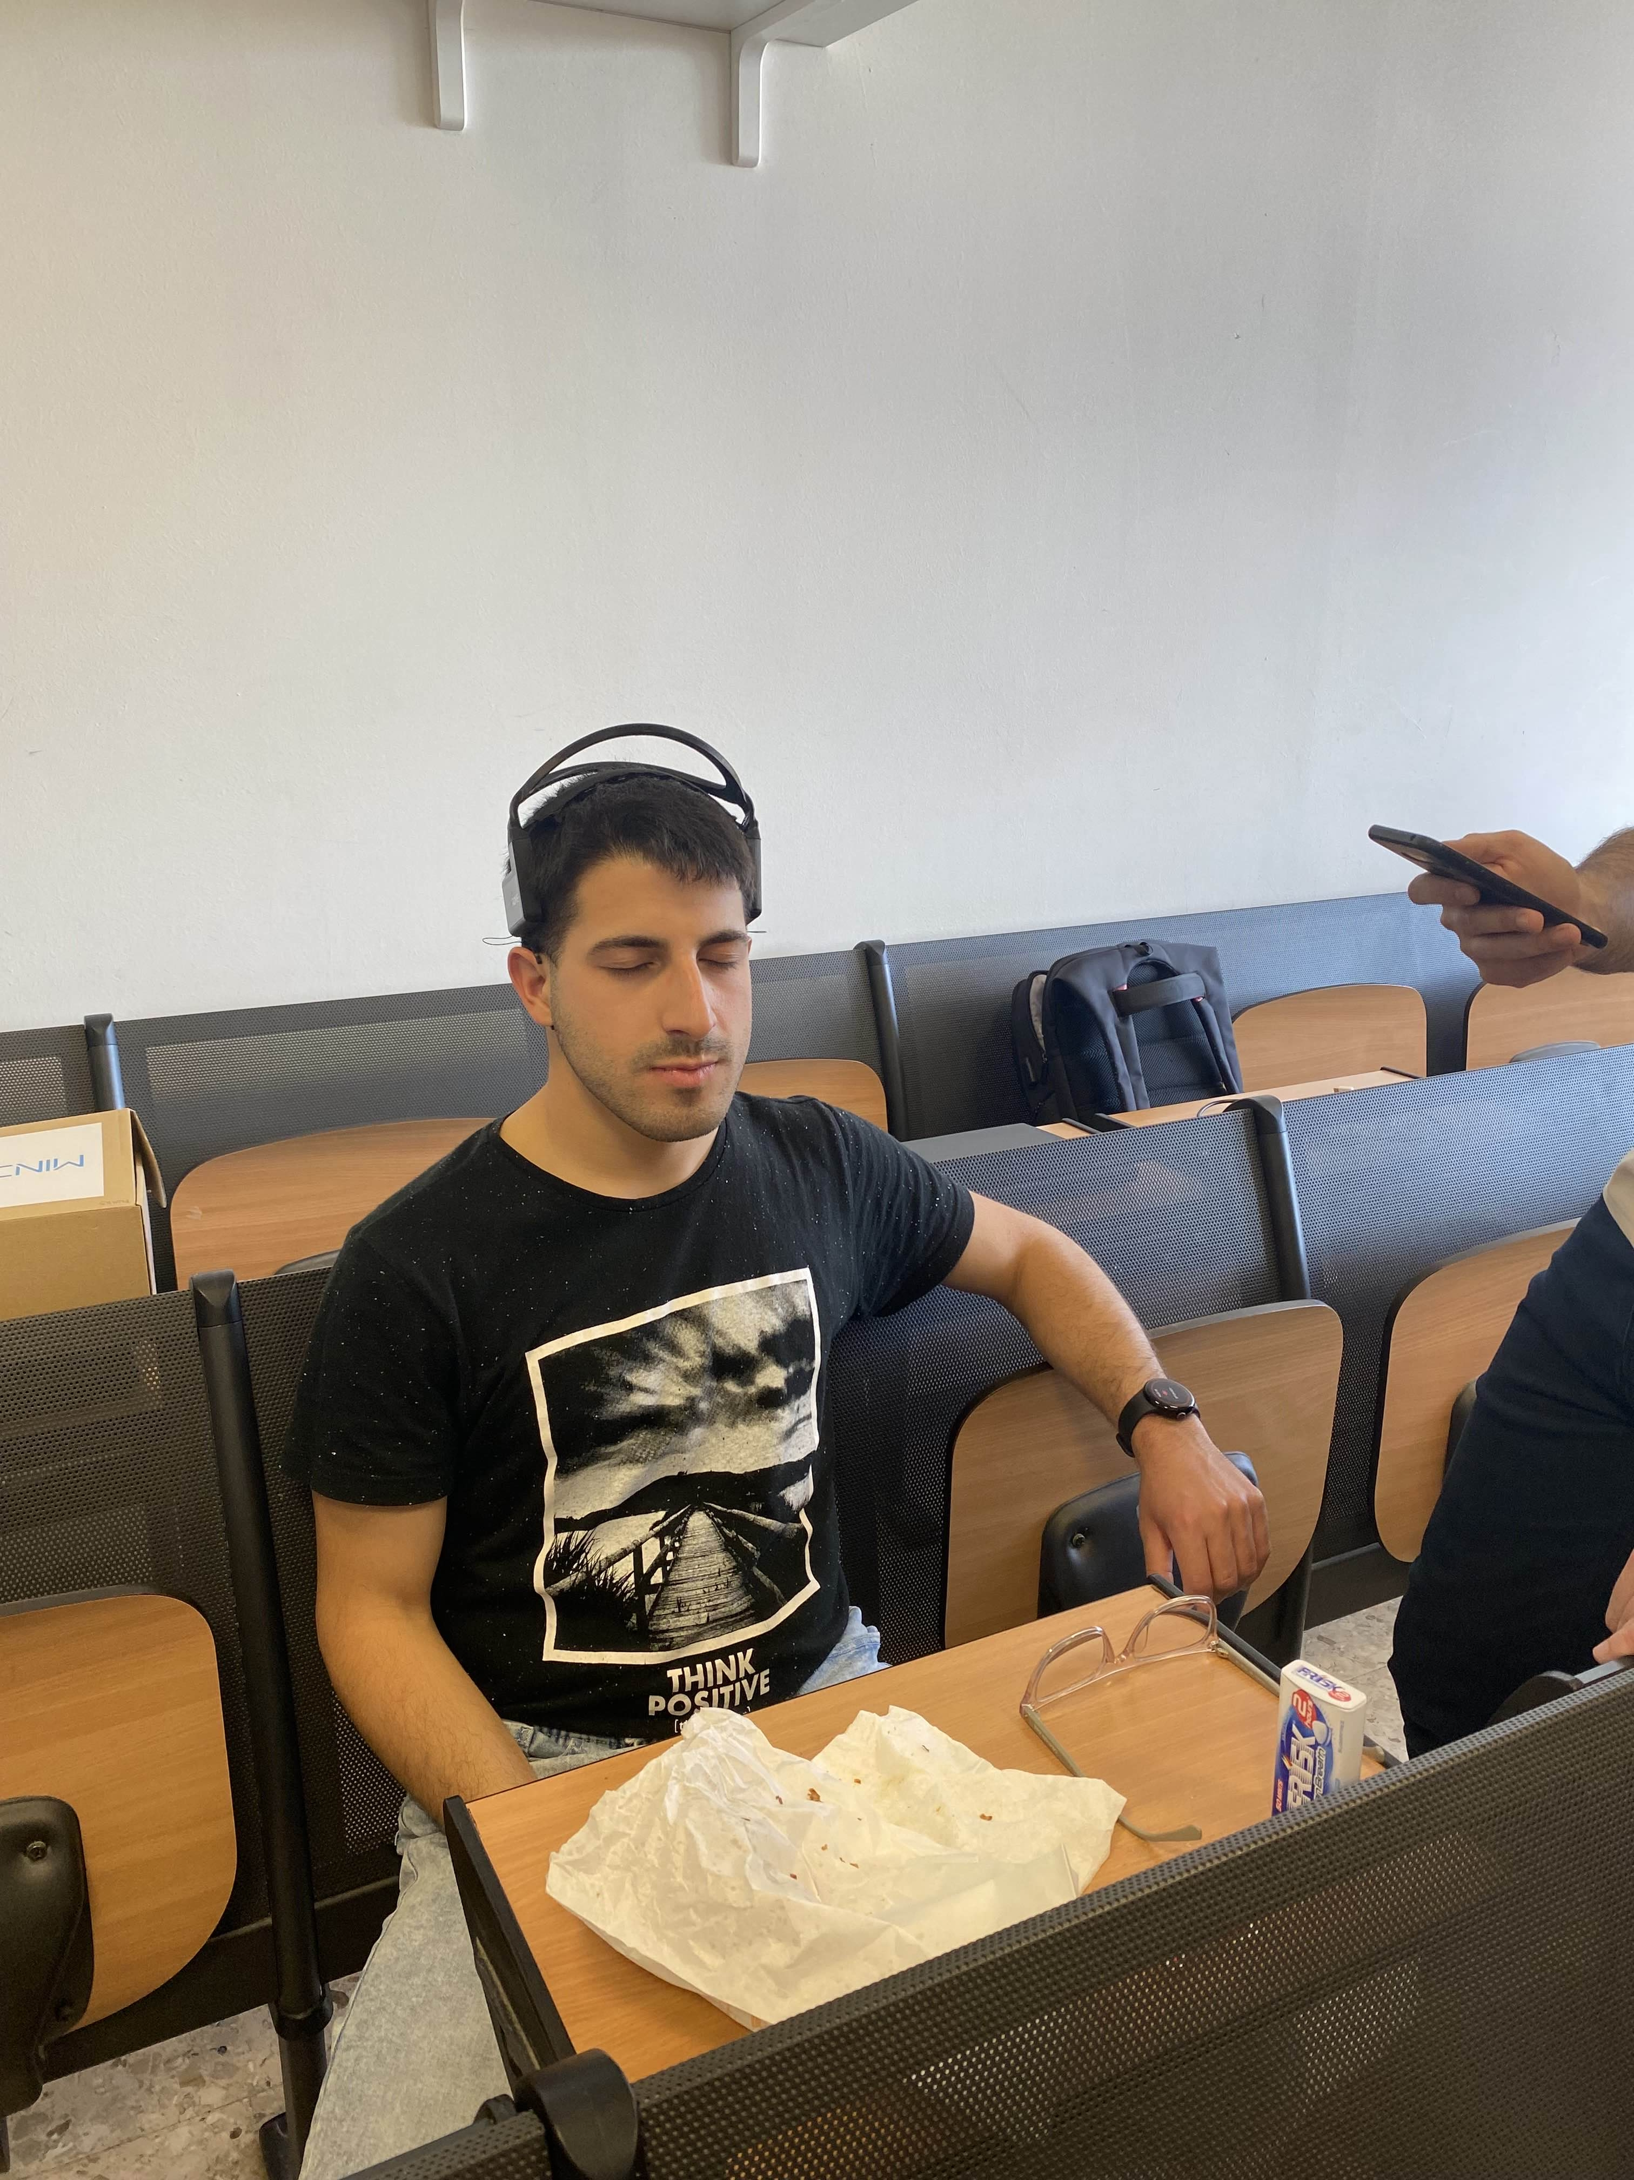

TASTING PROTOCOL
Device Initialization:
The protocol begins once EEG and wearable watch (HR & EDA) are connected and ready to transmit data
Preparation Phase (5 seconds):
A first beep signals the subject to bring the food sample into the mouth
This is a 5-second window to prepare for tasting
Recording Phase (10 seconds):
A second beep marks the start of data recording
For the next 10 seconds, the system captures EEG, HR, and EDA signals, representing the subject’s sensorial response to the food
Rating Phase:
A final beep ends the data capture
A rating interface appears for the administrator to input the subject's sensorial experience rating

Slide 16
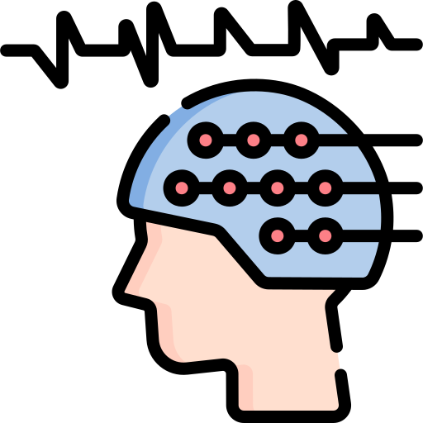
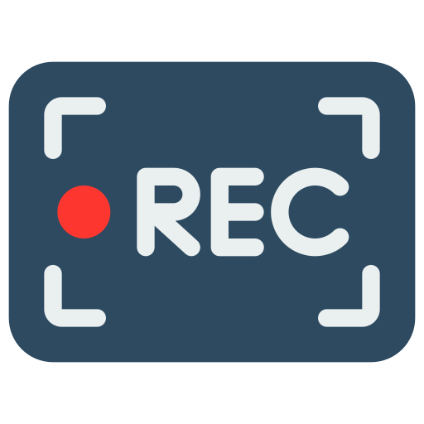
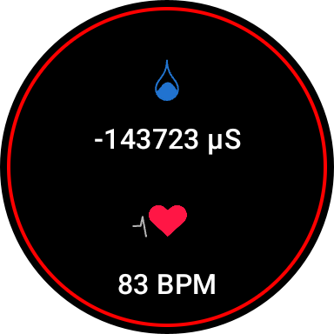
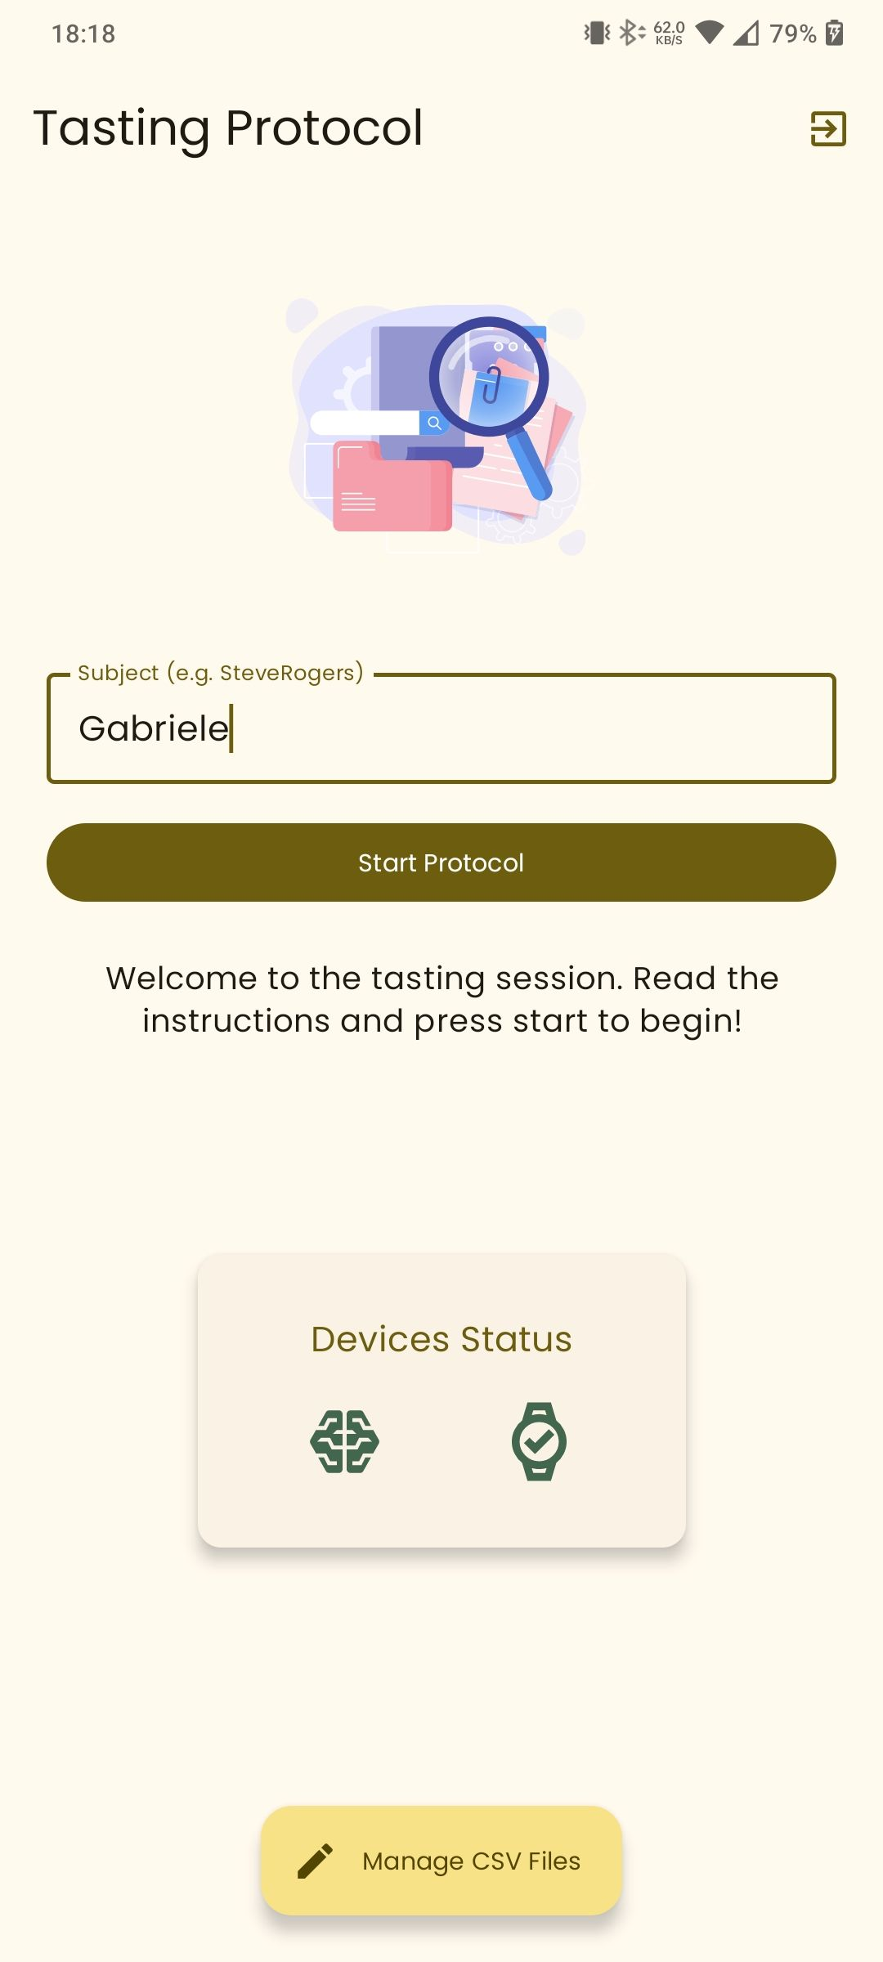
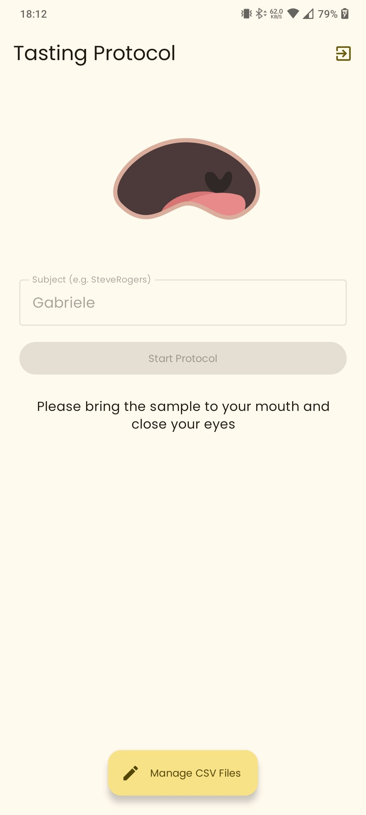
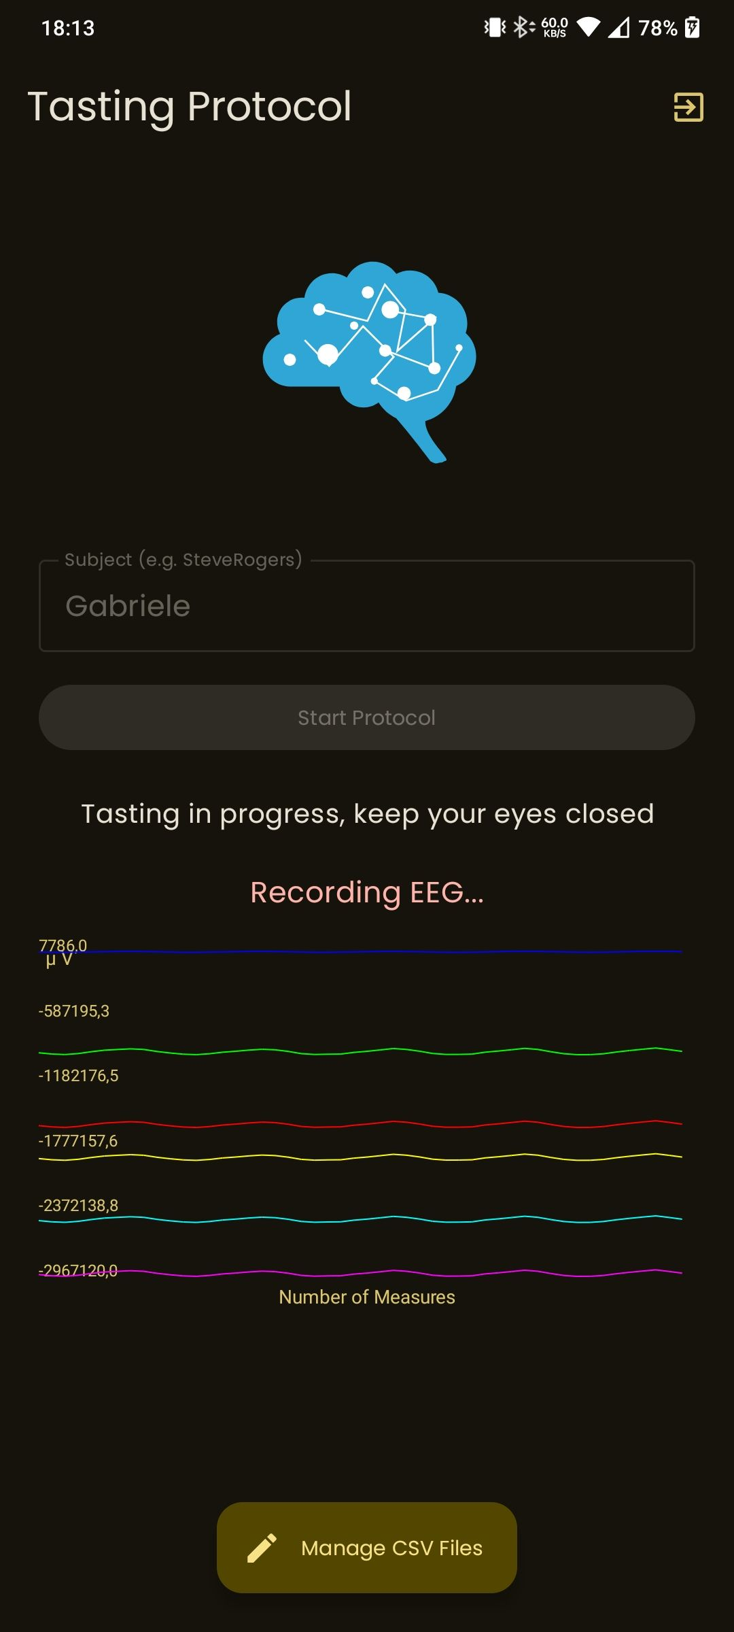



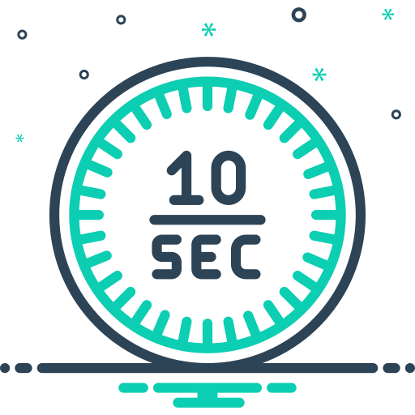
TASTING PROTOCOL (2)
Health check on devices status
Starting the protocol
Preparation phase of 5 secs
EEG and Wearable data recording phase of 10 secs

Slide 17
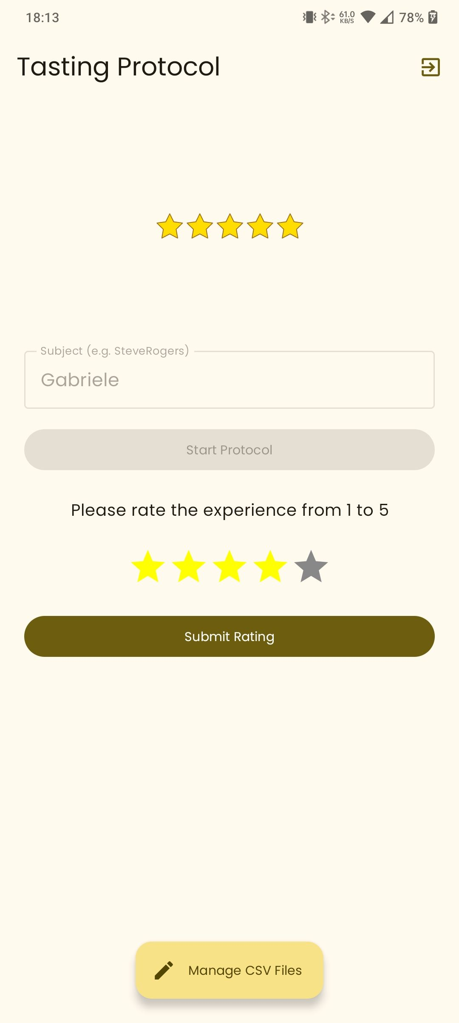
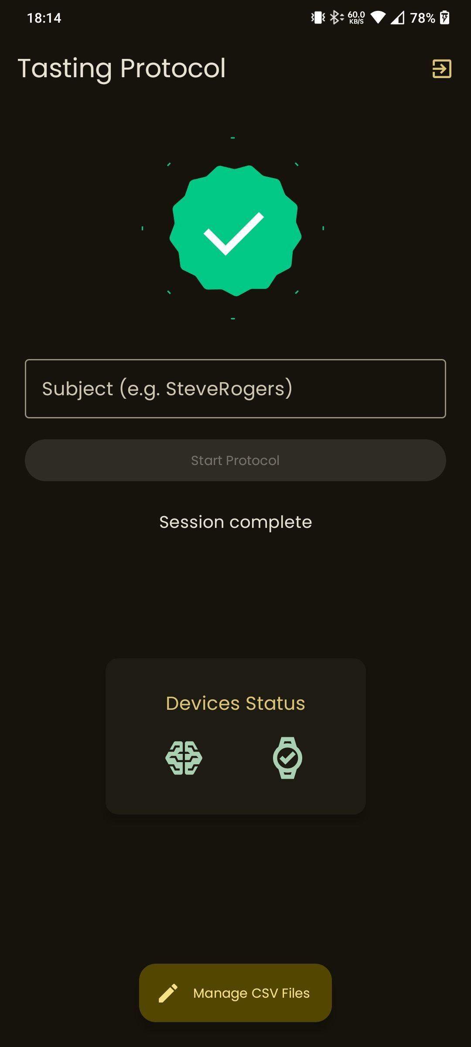
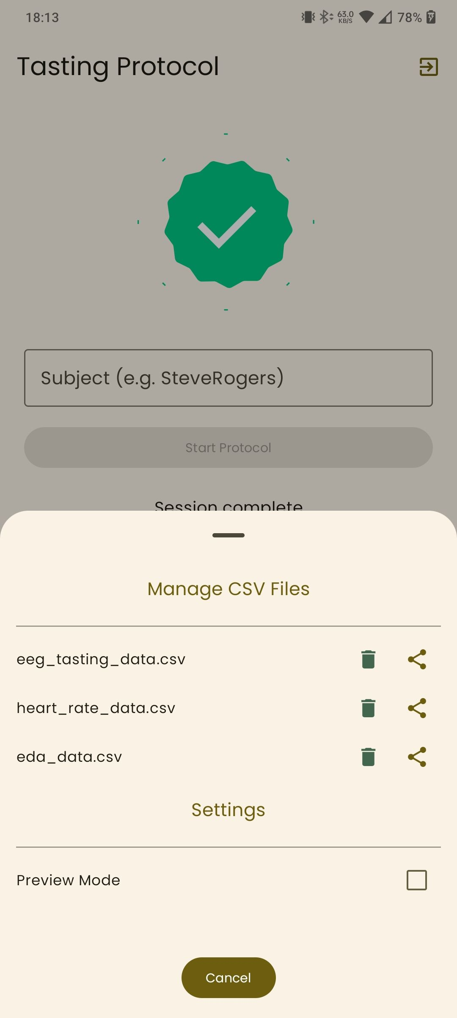


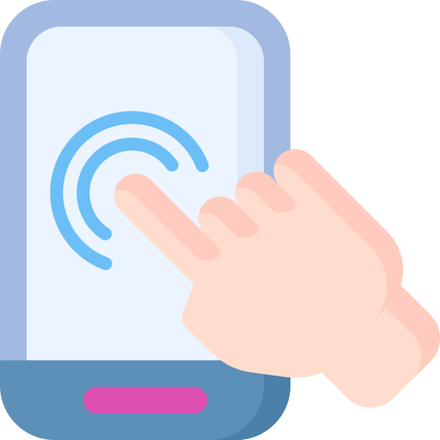
TASTING PROTOCOL (3)
Rating the sensorial experience
Data collected and session completed
Manage your data in one-tap

Slide 18





TASTING PROTOCOL
PREVIEW MODE
A complex protocol requires clear instructions
How do we help subjects understand each step to optimize data quality?
Preview Mode
Train participants with full protocol exposure
Identify and fix signal issues
All steps are performed exactly as in the real session, but no data is saved

Slide 19

Our Homemade Dataset
Small but Gathered with Love
45
TOTAL TASTING SESSIONS
10
A bottom sheet lets you delete or share CSV files individually, making it easy to export data for training after experiments.
PARTICIPANTS
(ages 16–56)
Data collected via the App in Admin mode:
Manages cues and rating input;
Streams EEG from MindRove Arc;
Triggers smartwatch HR and EDA recording;
Saves one CSV per sensor, preserving native sampling rates.
CSV Management

Slide 20

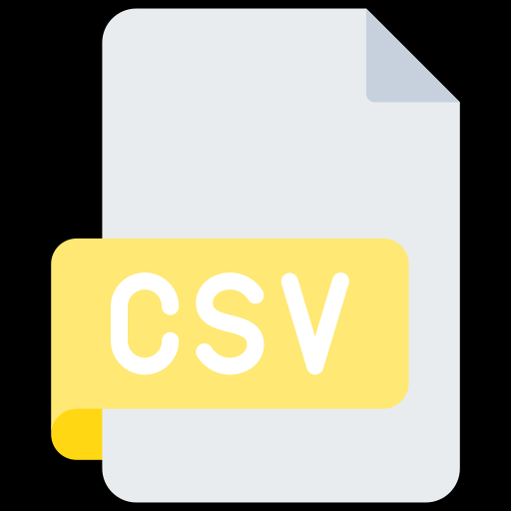





Pre-Processing
Sampling Frequency
TRAINING SET
500 Hz
TEST SET
EEG
HOLD-OUT
SPLITTER
TRAINING SET
~1 Hz
Upsampling
80/20
125 Hz
Split by Experiment
TEST SET
HR
TRAINING SET
~10 Hz
Upsampling
125 Hz
TEST SET
EDA

Slide 21
What is an Epoch?
INFO
The epochs form the input units for the machine learning model.
10 s
TASTING SESSION
2 s
=
5
SEGMENT
This is an Epoch
1 Experiment
5 Epochs

Slide 22


EEGNet
Lawhern et al. (2018)
Compact CNN specifically designed for EEG.
Tiny two-layer footprint, ideal for small EEG datasets
The Kitchen-Ready Classifier Adopted
Depthwise convolutions for learning spatial patterns.
1781
TRAINABLE
1861
TOTAL PARAMETERS
80
NON-TRAINABLE

Slide 23

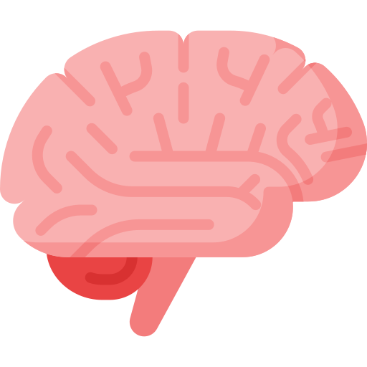

TENSORFLOW GRAPH
Very few details
EMBEDDED EEG PRE-PROCESSING
All EEG pre-processing steps are fused directly into the TensorFlow model, so no external DSP or signal handling is needed on-device.
2 s
EPOCH
PREDICTED RATING
Foodback ML Model
Simplifies the deployment on Kotlin

Slide 24
TENSORFLOW GRAPH
A bit more detail
EMBEDDED EEG PRE-PROCESSING
CH1
CH2
RAW
CH3
SAMPLES
500 Hz
6 x 1000
EEG
CH4
CH5
CH6
UPSAMPLED
SAMPLES
125 Hz
1 x 250
HR
PREDICTED RATING
UPSAMPLED
Foodback ML Model
125 Hz
SAMPLES
EDA
1 x 250

Slide 25
TENSORFLOW GRAPH
A bit more of more detail
EMBEDDED EEG PRE-PROCESSING
CH1
CH2
RAW
CH3
SAMPLES
500 Hz
6 x 1000
EEG
CH4
CH5
CH6
UPSAMPLED
SAMPLES
125 Hz
1 x 250
HR
PREDICTED RATING
UPSAMPLED
SAMPLES
125 Hz
1 x 250
EDA

Slide 26
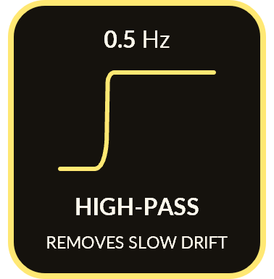
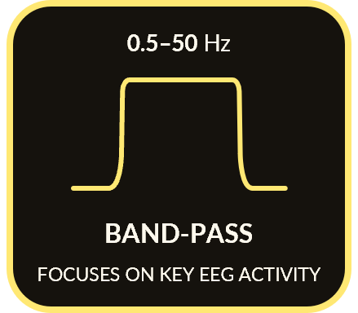
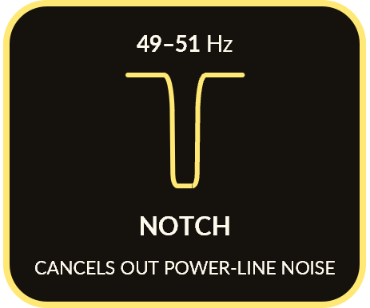
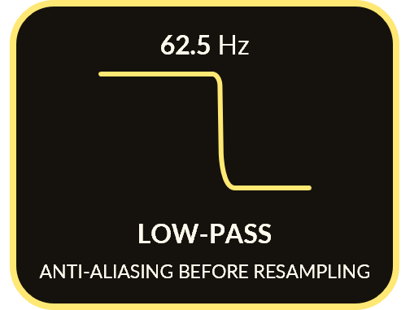
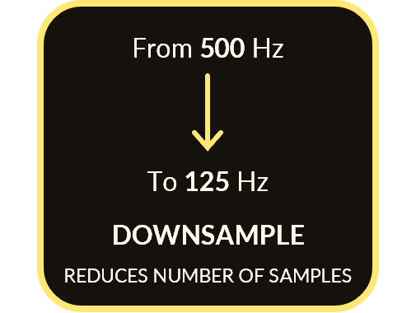
TENSORFLOW GRAPH
A bit more of more detail
EMBEDDED EEG PRE-PROCESSING
CH1
CH2
RAW
CH3
SAMPLES
PER CHANNEL
500 Hz
6 x 1000
NORMALIZATION
EEG
CH4
USING TRAINING-SET STATISTICS
CH5
CH6
UPSAMPLED
SAMPLES
PER CHANNEL
125 Hz
1 x 250
NORMALIZATION
HR
PREDICTED RATING
USING TRAINING-SET STATISTICS
SAMPLES
UPSAMPLED
SAMPLES
6 x 250
125 Hz
1 x 250
EDA
SAMPLES
1 x 250
8 INPUT CHANNELS
5 OUTPUT CLASSES
PER CHANNEL
SAMPLES
NORMALIZATION
1 x 250
EEGNet
USING TRAINING-SET STATISTICS
Lawhern et al. (2018)

Slide 27


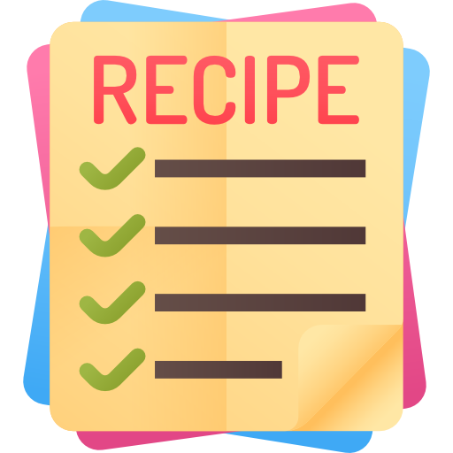

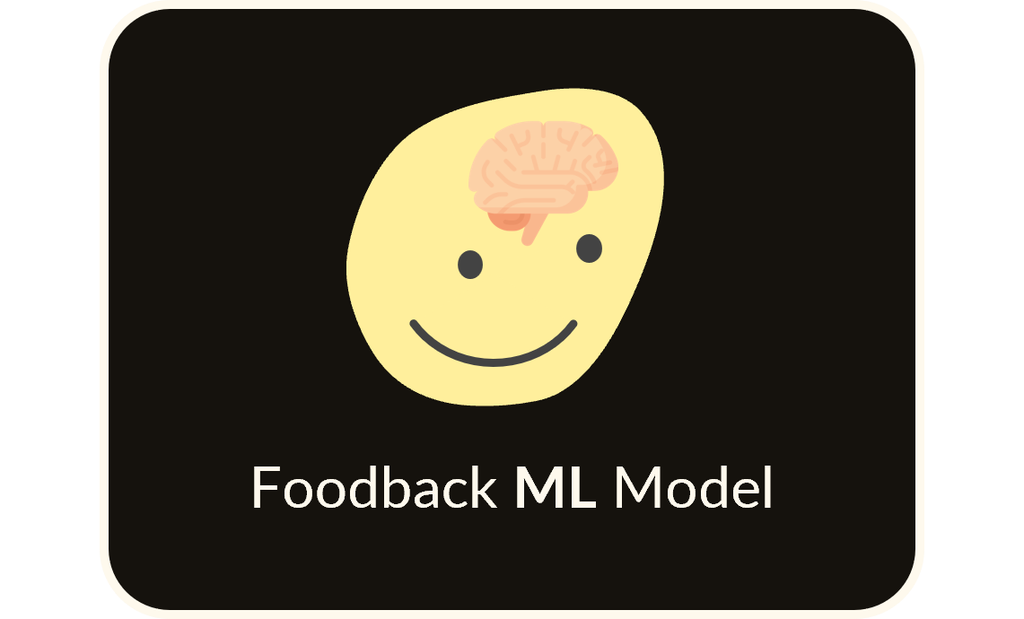
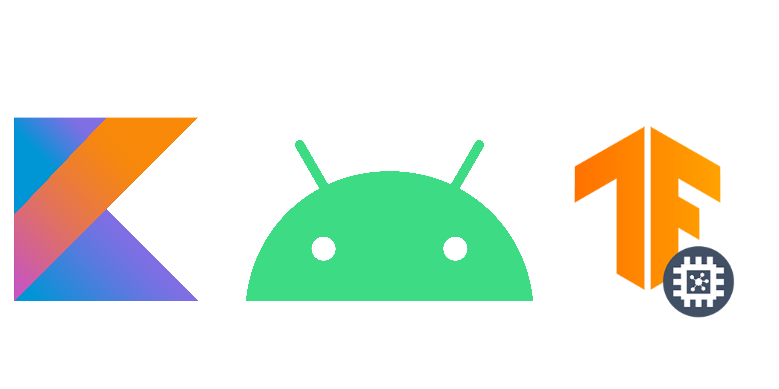
MODEL TRAINING & EVALUATION
TRAINING SET
TRAINING SET
TRAINING SET
BATCH SIZE: 128
ITERATIONS: 1000
VALIDATION: 10%
DEPLOYMENT
Final model exported as a .tflite file, ready for on-device inference via the Foodback app.
TEST SET
33.3 %
TEST SET
TEST ACCURACY
TEST SET

Slide 28




A TEMPTING ATTEMPT
Epoch-Level Split
80/20 split applied randomly across 2-second epochs
73.3 %
But too sweet to trust
TEST ACCURACY
Why it’s misleading:
Information leakage from overlapping sessions
Model may memorize session-specific noise or context
Overestimates real-world performance

Slide 29



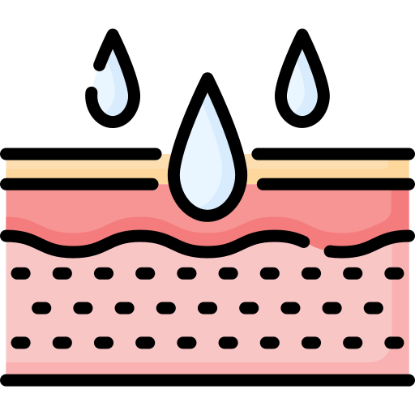



EVALUATION PROTOCOL
Raw Data
Ch1
Ch2
Ch3
Ch4
SAMPLES 6x1000
Ch5
Ch6
500 Hz
Predicted Rating
~10 Hz
SAMPLES
250
~1 Hz
SAMPLES
250
Upsampling
The evaluation phase captures 2-second samples

Slide 30
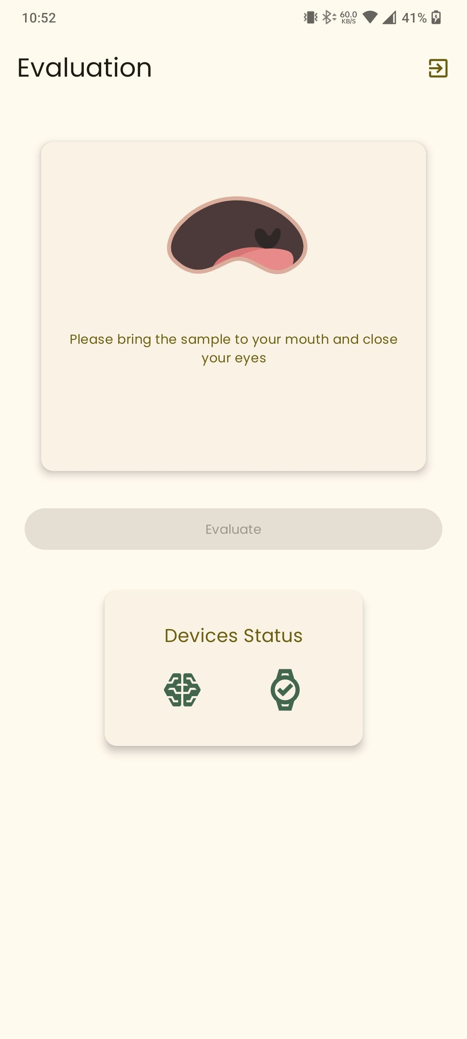
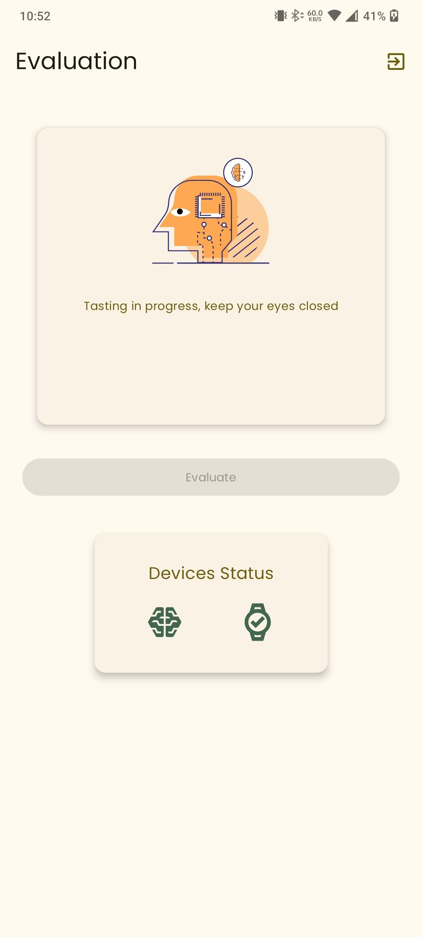
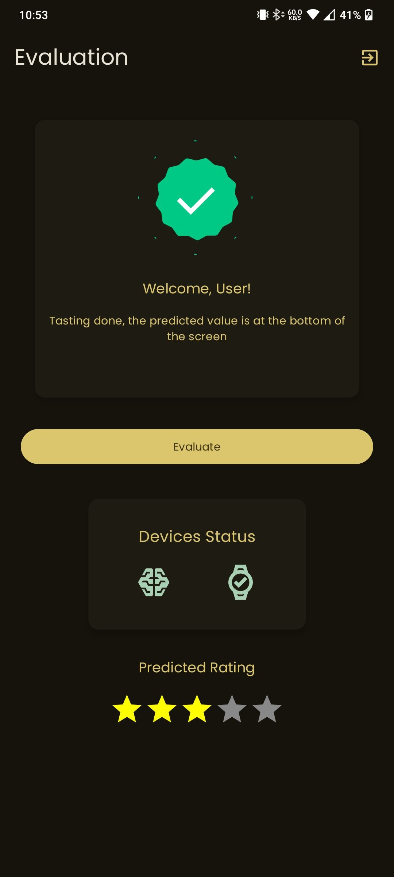
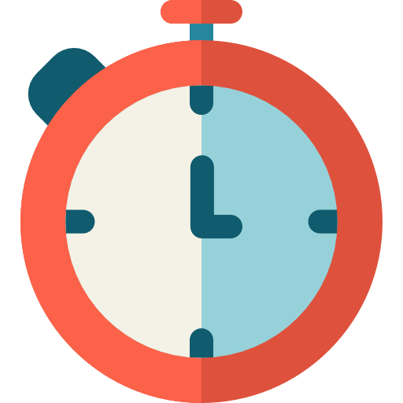
EVALUATION PROTOCOL
(2)
Health check on devices status
Preparation phase of 5 secs
Data collection and model prediction for 2 secs
Score prediction

Slide 31







FUTURE WORK
A key future goal is to enhance the application to automate the full review process and exploring richer output formats (e.g. free-text review generation)
To enhance model accuracy and generalizability, future work should include data collection from a larger and more diverse population

Slide 32



CONCLUSIONS
Just a Prototype
Observed classification performance reflects the true complexity of decoding human taste perception
Technical viability of real-time, on-device inference

Slide 33
byte
What if a single could speak for itself now?
bite

Slide 34
What if a single could speak for itself now?
byte
Thanks for your attention

